Slide 1
Best location for a New Bubble Tea Joint in Singapore
August 9, 2021

Slide 2
Background & Problem Statement
Singaporeans' love affair with bubble has been well documented pre-pandemic as well as during the pandemic. Even with restrictions on dining-in hit drink stalls at hawker centres, food courts and restaurants hard, but bubble tea joints continue to enjoy roaring success evidenced by unending ques of customers and food delivery riders at bubble tea shops. As reported in The Straits Times, Nayuki, a Chinese bubble tea chain raised more than US$650 million in an initial public offering (IPO).
This project will explore the best location with high human traffic to set-up a bubble tea shop. The locations with high human traffic is usually located around Mass Rapid Transit (MRT) stations which is one of the 2 main modes of transportations in Singapore, with the other one being the bus. As such, we will explore the best location which would be one with the fewest number of bubble tea joints within the vicinity and closest to Singapore's Central Business District to set-up a bubble tea shop within walking distance (300m radius) from a MRT station.
People interested in investing in bubble tea joints would be interested to know the locations with the fewest bubble tea joints and their distance to Singapore’s Central Business District.

Slide 3
Data Sources
For this project, I'll leverage Singapore MRTs' coordinate dataset from yxlee https://www.kaggle.com/yxlee245/singapore-train-station-coordinates. As this dataset contains both MRT and LRT, we'll need to remove LRT from the dataset before using it. I'll also be using the FourSquare API to obtain all the bubble tea joints within 300m radius from the MRT stations located in the Singapore MRTs' coordinates dataset. Features of interest will be venue, venue latitude, venue longitude, venue category data. I’ll also be obtaining Singapore’s coordinates as well as Singapore’s Central Business District’s (CBD) coordinates with foursquare API.

Slide 4
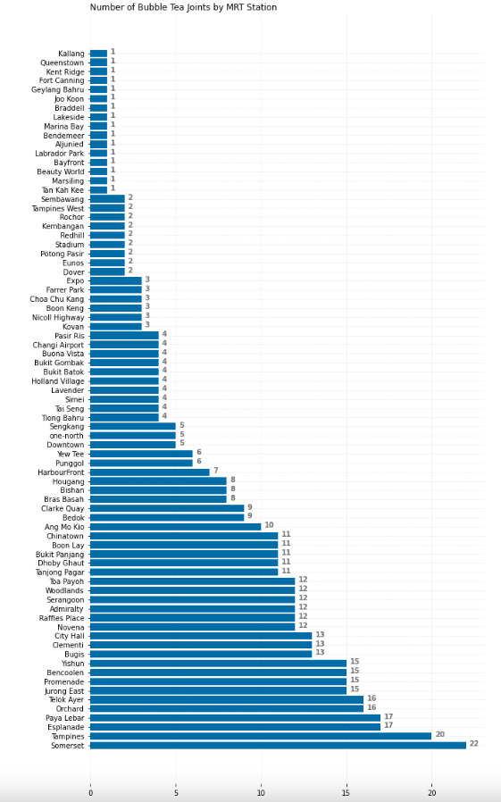
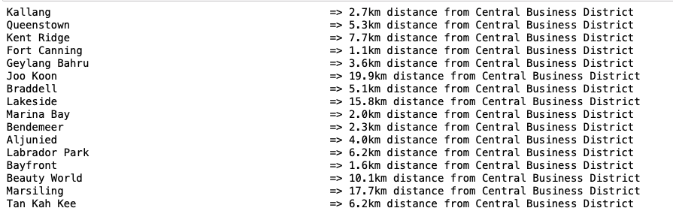
Analysis
From the output data from the query, the data shows that there 16 MRT stations with the fewest number of bubble tea joints, which are, Kallang, Queenstown, Kent Ridge, Fort Canning, Geylang Bahru, Joo Koon, Braddell, Lakeside, Marina Bay, Bendemeer, Aljunied, Labrador Park, Bayfront, Beauty World and Marsiling as shown in the figure on the left.
To further narrow down the MRT locations for the best bubble tea joint, we proceed to calculate the distance between the 16 MRT stations and Singapore’s Central Business District (CBD). Using geodesic, the MRT station closest to CBD is Fort Canning MRT.

Slide 5
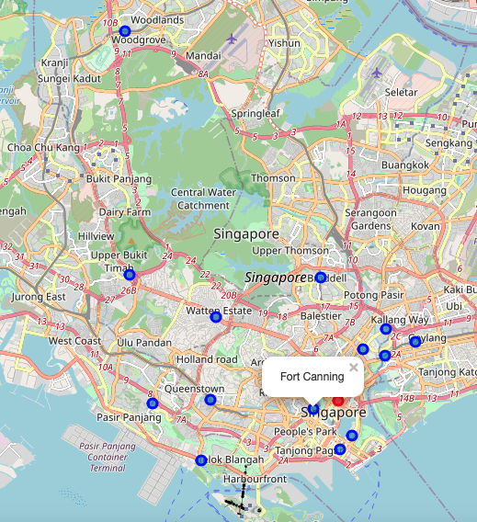
Conclusion
The purpose of this project was to identify the best location for a new bubble tea joint that has the fewest number of bubble tea joints and is the closest to Singapore's Central Business District (CBD).
By calculating and visualising bubble tea joints density with a bar chart and folium, we've identified 16 probable MRT locations for further analysis.
After that, we proceeded to identify the coordinates for Singapore's CBD and calculated the distance between the 16 identified MRT locations and Singapore CBD and arrived at the conclusion that Fort Canning MRT is the best location based on fewest number of bubble tea joints and closest distance to Singapore's CBD. Final decision for the optimal bubble ta joint would need to take into consideration of additional factors such as real estate availably, prices, social and economics of the neighbourhoods closest to the MRTs.

